Slide 1
Large Scale Data Processing

Slide 2
How large is large?
10 Gigabytes?
100 Gigabyte?
1 Terabyte?
1 Petabyte?
…??

Slide 3

Pictures from MBAonline.com

Slide 4
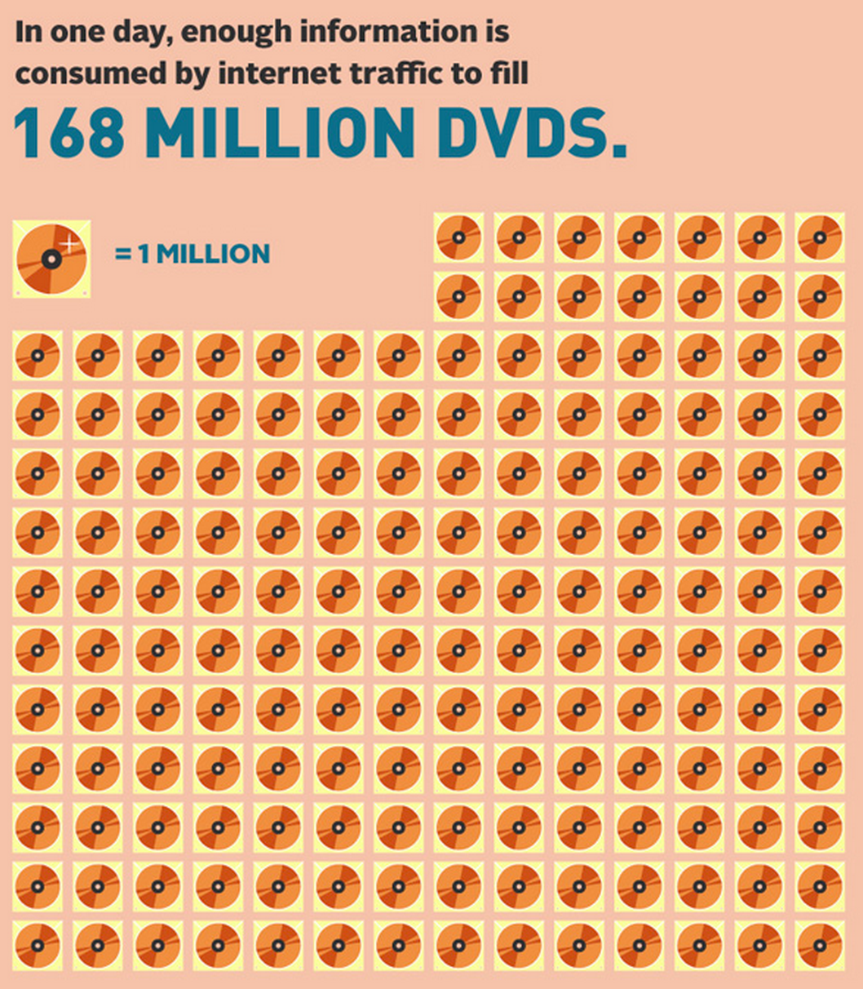
Picture from the Internet

Slide 5
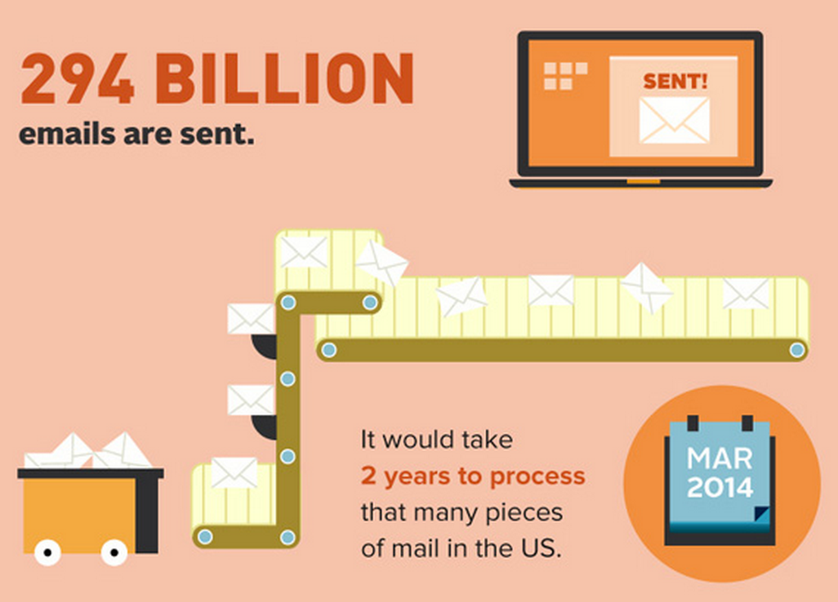
Picture from the Internet

Slide 6
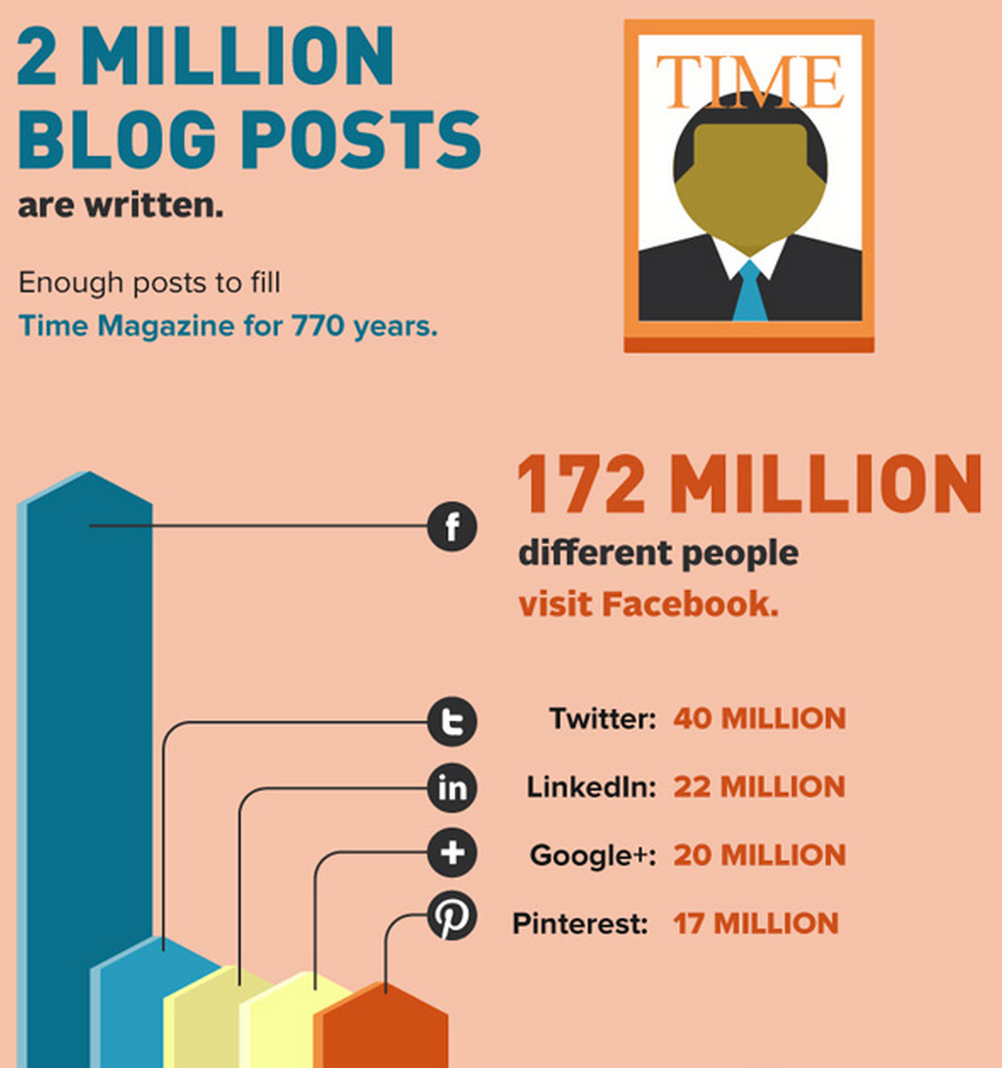
Picture from the Internet

Slide 7
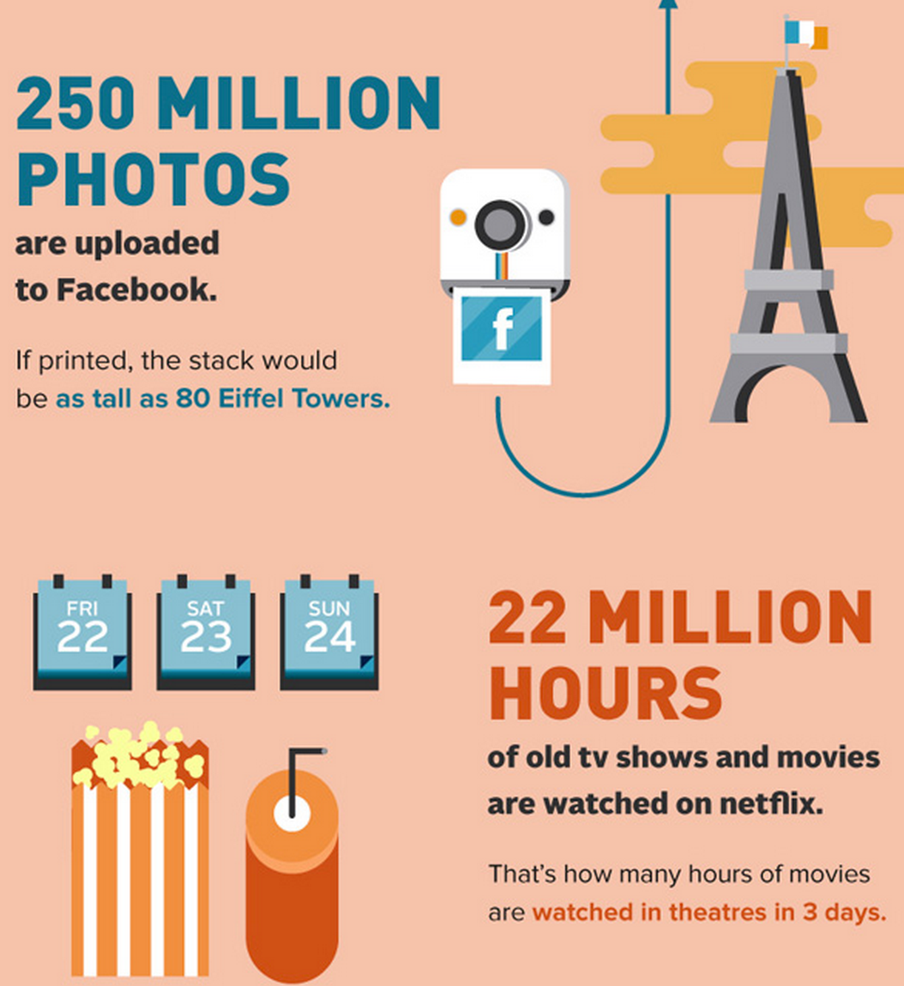
Picture from the Internet

Slide 8

Data cannot be efficiently processed by one machine
The algorithms as well as their implementations are mainly single machine version.
Most of them run in single thread/process.
Time is money!

Slide 9
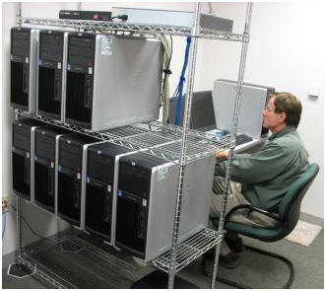
Computers. A lot of them!
You probably need.
A small cluster

Slide 10
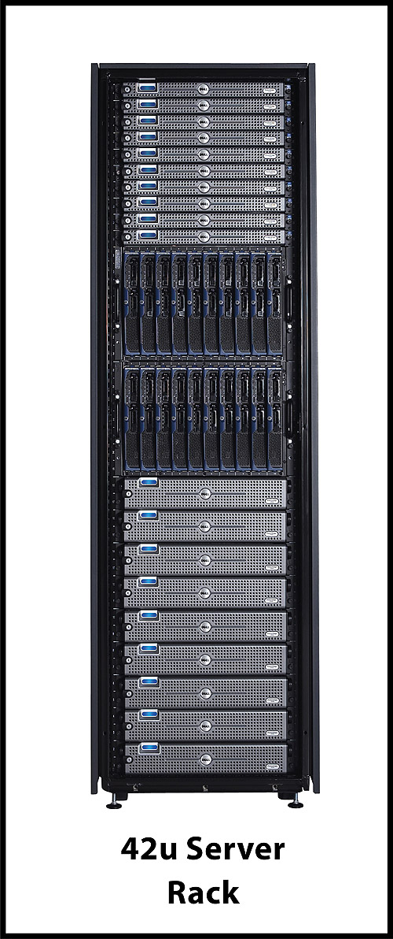

Computers. A lot of them!
You probably need.
Or a rack Or a data center
A small cluster

Slide 11




Those cost too much!
Use (IaaS) cloud service

Slide 12




Computing Framework
Map-Reduce
Hadoop
Bulk Synchronous Parallel (BSP)
Giraph
Hama
In-memory Cluster Computing
Spark

Slide 13
Map-Reduce
Distributed computing framework running on top of commodity computers.
First time draw attention.
Google’s distributed computing framework: MapReduce: Simpliﬁed Data Processing on Large Clusters, OSDI 2004.
Get popular.
Apache Hadoop. Doug Cutting and Mike Cafarella et al. 2005.
1.2.X Hadoop 1.
2.2.X Hadoop 2 (YARN).

Slide 14
Why Map-Reduce?
The size of data has far beyond the processing capability of the single machine.
Example: A small search engine
20+ billion billion web pages x 20KB = 400+ TB
1 computer reads 30-35MB/sec from disk would use 4+ month to just read all the data.
~1000 hard drives to store the data.
Much more time to do something to the data…

Slide 15
Why Map-Reduce? (Cont)
Super-computer
Too expensive
Requires non-trivial extra time to train the programmer
Traditional parallel computing framework
Requires knowledge of low-level details: communication, fault-tolerance
Difficult to maintain
Programmer would be distracted

Slide 16
Fundamentals of Map-Reduce
Two Main Steps:
Map: Extract something you care about.
Map<Key1, Value1> -> Key2, Value2
Reduce: Aggregate, Summarize, Filter, Or Transform
Reduce<Key1, List(Value1)> -> Key2, Value2

Slide 17

Apache Hadoop
A Java implementation of Map-Reduce.
Initialized by Yahoo!
An Apache open source project. Initially a sub-project of Apache Nutch, a web crawler system.

Slide 18
Hadoop 2 Ecosystem
MapReduce
YARN Resource Management
Hadoop Distributed File System

Slide 19



Hadoop 2 Ecosystem
MapReduce
YARN Resource Management
Hadoop Distributed File System

Slide 20



Hadoop 2 Ecosystem
MapReduce
YARN Resource Management
Hadoop Distributed File System

Slide 21
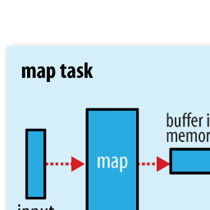
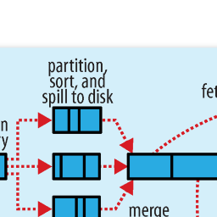
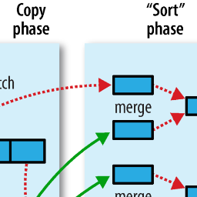
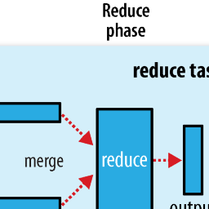

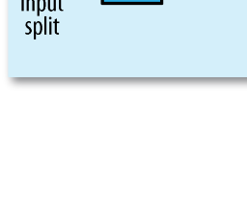
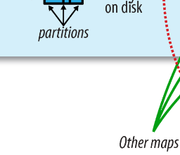
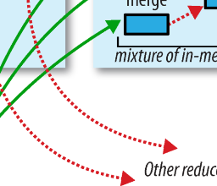
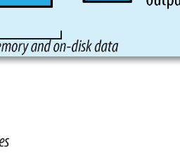

Procedures in Hadoop
from Hadoop: The Definitive Guide

Slide 22
Main API
Mapper:
setup(Context context)
map(Key1 key, Value1 value, Context context)
cleanup(Context context)
Reducer:
setup(Context context)
reduce(Key3 key, Iterable<Value3> values, Context context)
WritableComparable
readFields(DataInput in)
Write(DataOutput out)
compareTo
Partitioner, InputFormat, InputSplit

Slide 23
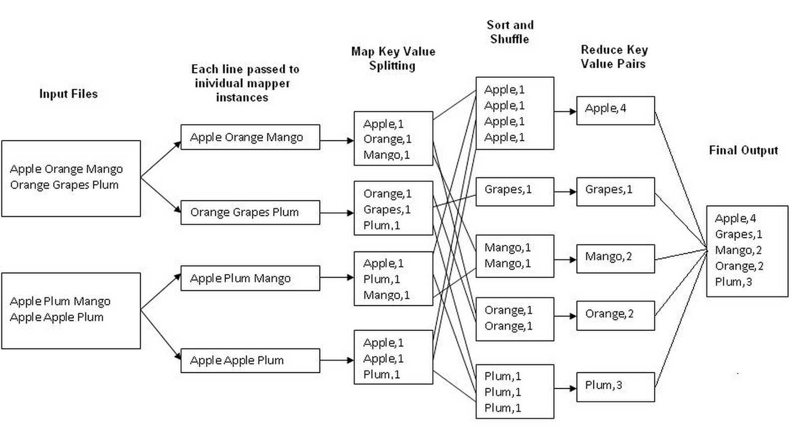
“Hello World” in Hadoop
Wordcount: count the number of each distinct word in a given set of documents.

Slide 24
Limitation of Map-Reduce
Large overhead (10-20 seconds start up time)
Not inherently support iteration
No message passing
Cannot get results in real time.

Slide 25
Limitation of Map-Reduce
Large overhead (10-20 seconds start up time)
Not inherently support iteration
No message passing
Cannot get results in real time.
Extensions:
HaLoop: Efficient Iterative Data Processing on Large Clusters, VLDB 2010.
Twister: Iterative Hadoop. http://www.iterativemapreduce.org/.

Slide 26
Apache Spark
In-memory cluster computing framework.
Implemented in Scala, a OOP and functional programing language.
Invented by AMP Lab of University of California Berkeley, lead by Michael Franklin, Michael Jordan and Ion Stoica.
Designed and developed by a 79 people team.
Was contributed to Apache Software Foundation in 2013.

Slide 27
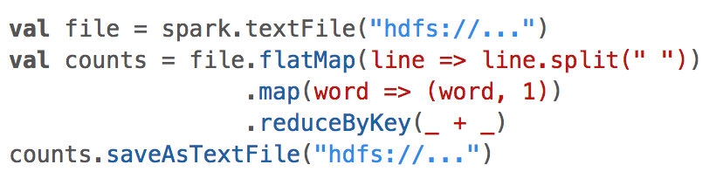
How concise it is?
An example Wordcount.

Slide 28
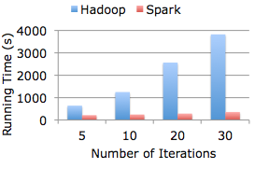
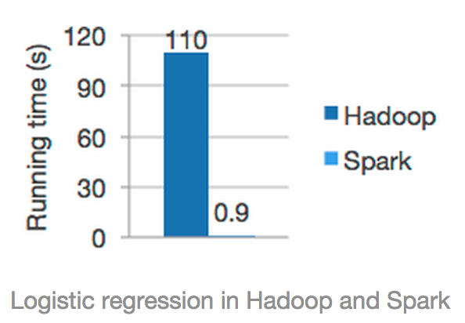
How fast it is?
Data: 30 GB
Machine: 80-core cluster
20x faster
Logistic regression
100x faster

Slide 29

Related Materials
Spark web site: http://spark.incubator.apache.org/
Github: https://github.com/apache/incubator-spark
User mailing list: user@spark.incubator.apache.org
Book: Learning spark, Mark Hamstra and Matei Zaharia.

Slide 30
Interactive Query System
Hive
Apache Hive is a data warehouse infrastructure built on top of Hadoop for providing data summarization, query, and analysis
Presto
Presto is an open source distributed SQL query engine for running interactive analytic queries against data sources of all sizes ranging from gigabytes to petabytes

Slide 31
Hive Features
Built on top of Hadoop.
Hive-QL
SQL-like declarative language which compiled into map-reduce jobs executed on Hadoops
Custom map-reduce scripts to be plugged into queries
User defined column transformation (UDF) and aggregation (UDAF) functions

Slide 32
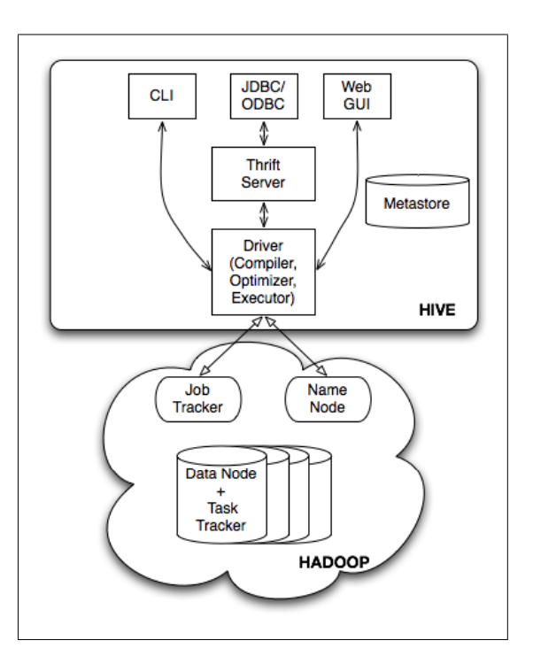
Hive Architectures
External Interfaces
Thrift Server
Metastore
Driver
Compiler
Execution Engine

Slide 33
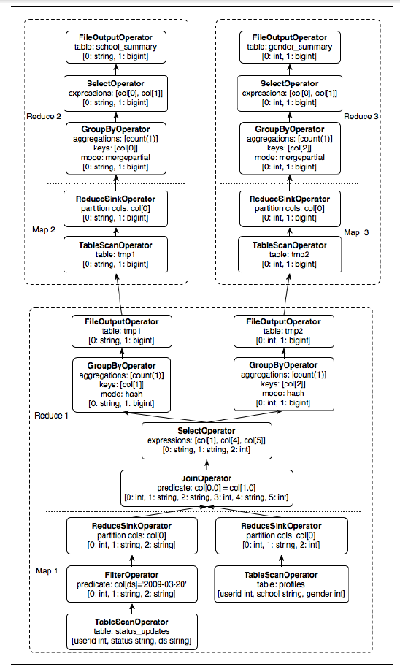
Hive Example
FROM (SELECT a.status, b.school, b.gender
FROM status_updates a JOIN profiles b
ON (a.userid = b.userid and
a.ds='2009-03-20' )
) subq1
INSERT OVERWRITE TABLE gender_summary
PARTITION(ds='2009-03-20')
SELECT subq1.gender, COUNT(1) GROUP BY subq1.gender
INSERT OVERWRITE TABLE school_summary
PARTITION(ds='2009-03-20')
SELECT subq1.school, COUNT(1) GROUP BY subq1.school
Hive-QL
Query Plan

Slide 34
Hive Reference
https://hive.apache.org/
http://www.vldb.org/pvldb/2/vldb09-938.pdf

Slide 35
Presto Features
Query interactively (in milli-seconds to minutes). Processing is in memory and pipelined across the network between stages which avoids unnecessary I/O and associated latency overhead.
Query across multiple data sources such as Hive, HBase, Cassandra, or even commercial DBs
Presto is 10x better than hive/Mapreduce in terms of cpu efficiency and latency for most queries.

Slide 36
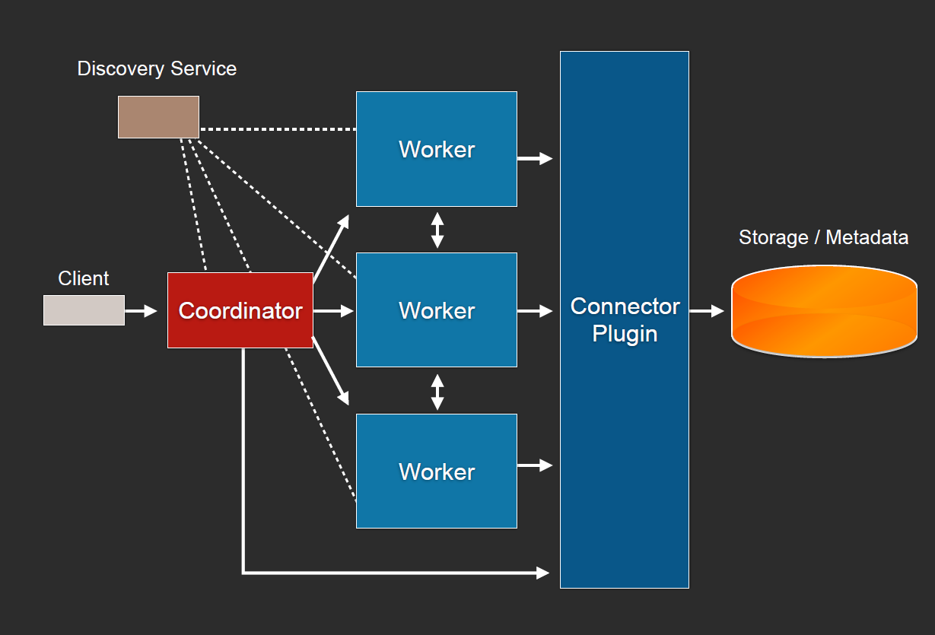
Presto Architectures

Slide 37
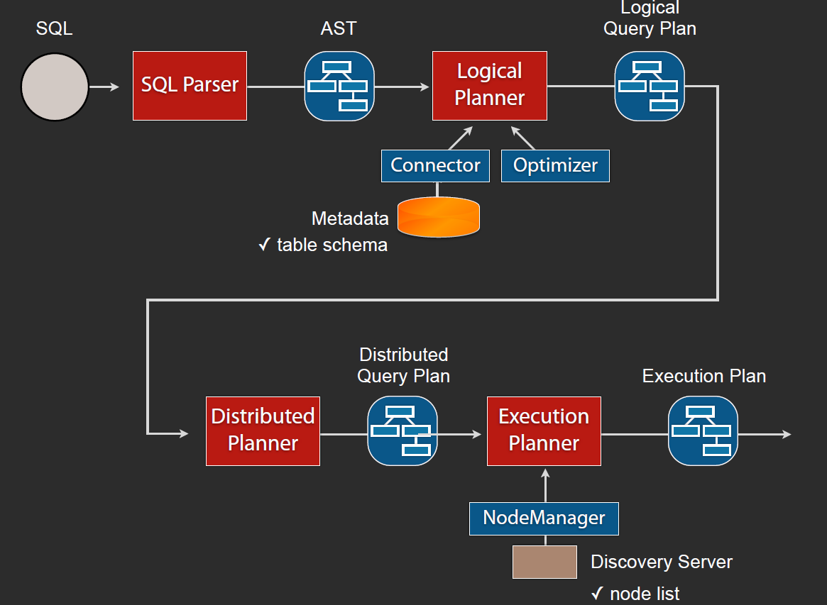
How Presto query runs?

Slide 38
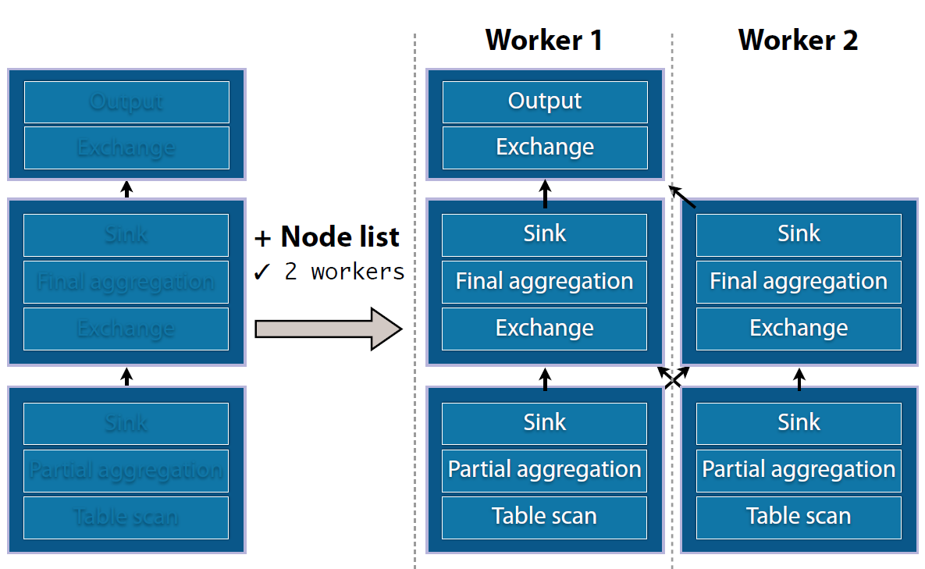
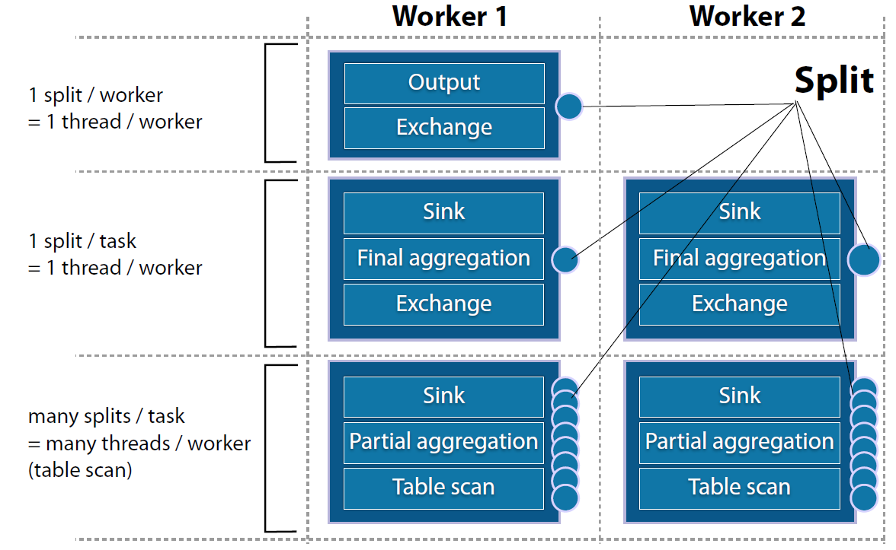
Presto Execution Plan

Slide 39
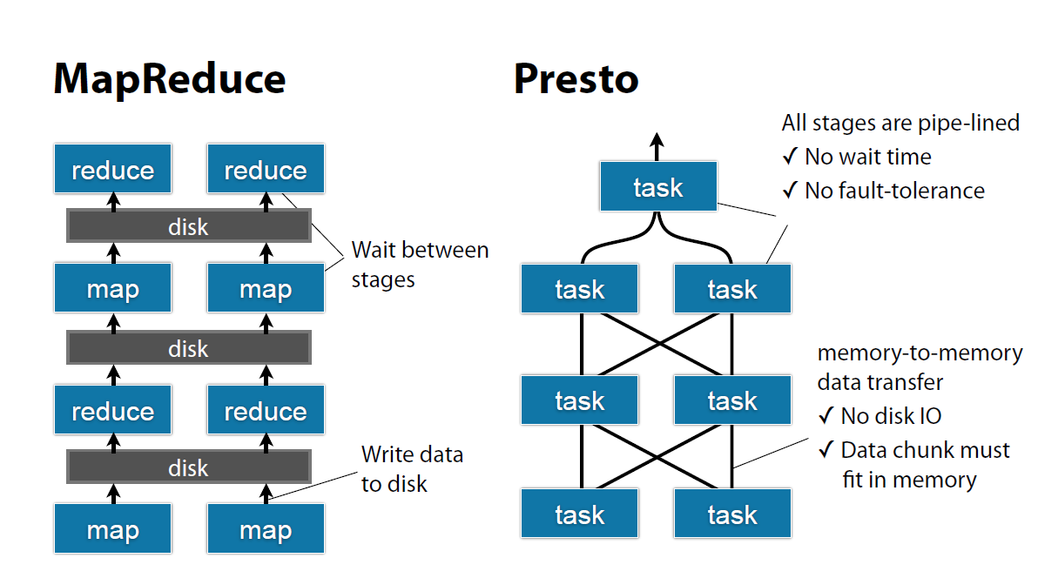
Presto vs Map-Reduce

Slide 40
Presto Reference
http://prestodb.io/
http://www.slideshare.net/frsyuki/presto-hadoop-conference-japan-2014

Slide 41
How to learn more?
Slideshare: Tons of interesting and useful slides.
InfoQ: A practitioner-driven community news site focused on facilitating the spread of knowledge and innovation in enterprise software development.
Top companies’ engineering blog: First-hand resource from the people who invented the things.
Quora: Ask question and get answers from the real domain experts!

